Slide 1
Branch, Merge, Commit – New forms of Open Source for Designing With BIM
Phil Langley
School of Architecture, University of Sheffield
https://github.com/phiLangley
arp12ppl@sheffield.ac.uk

Slide 2
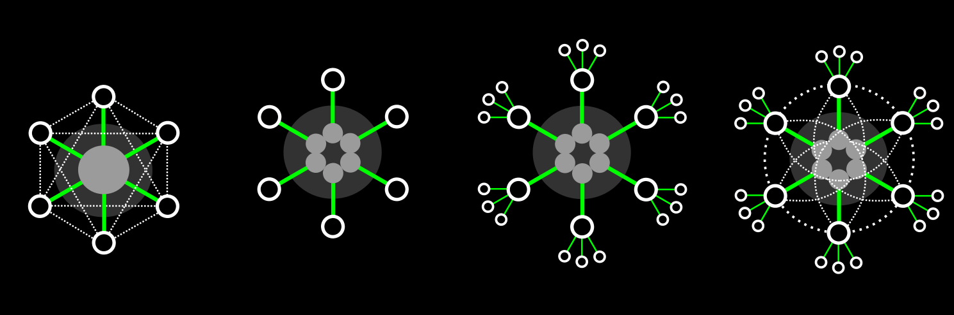
diagrams of BIM

Slide 3
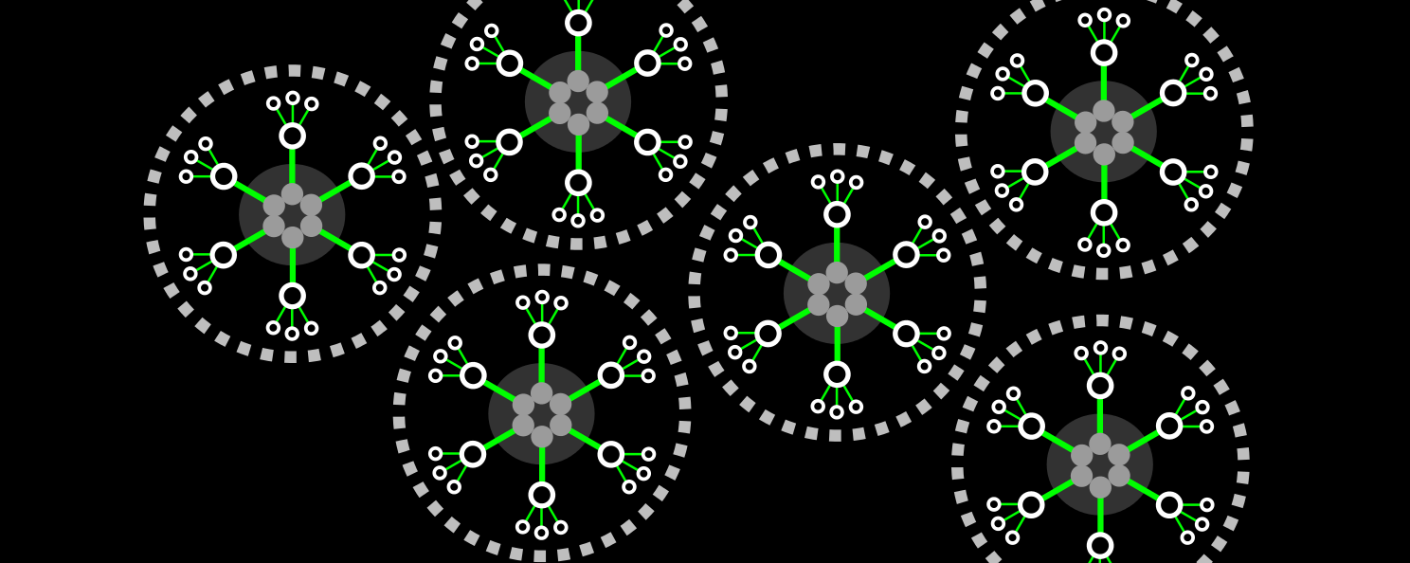
diagrams of BIM

Slide 4
collaborative
through the principle of the single, shared, central model
concurrent
the central model is the means by which contributions are made simultaneously
continuous
and this process should loop – from brief, to deign, to build, to client, back to brief

Slide 5
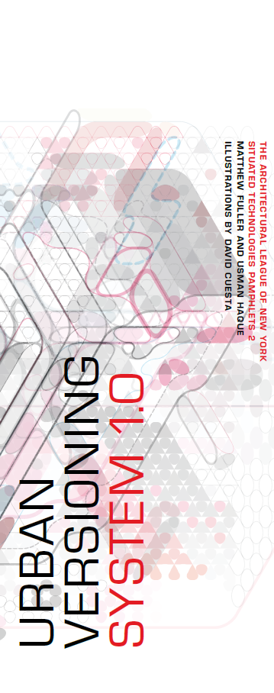
This document is a quasi-license. If its constraints are followed in the production of spatial structures, whether buildings or more fleeting constructions, you, and others, will be able to make something new or re-version something already there and you will be able to express clearly how others can participate or make use of the work you are creating.
“Urban Versioning” - Fuller and Haque
http://www.situatedtechnologies.net/?q=node/85

Slide 6
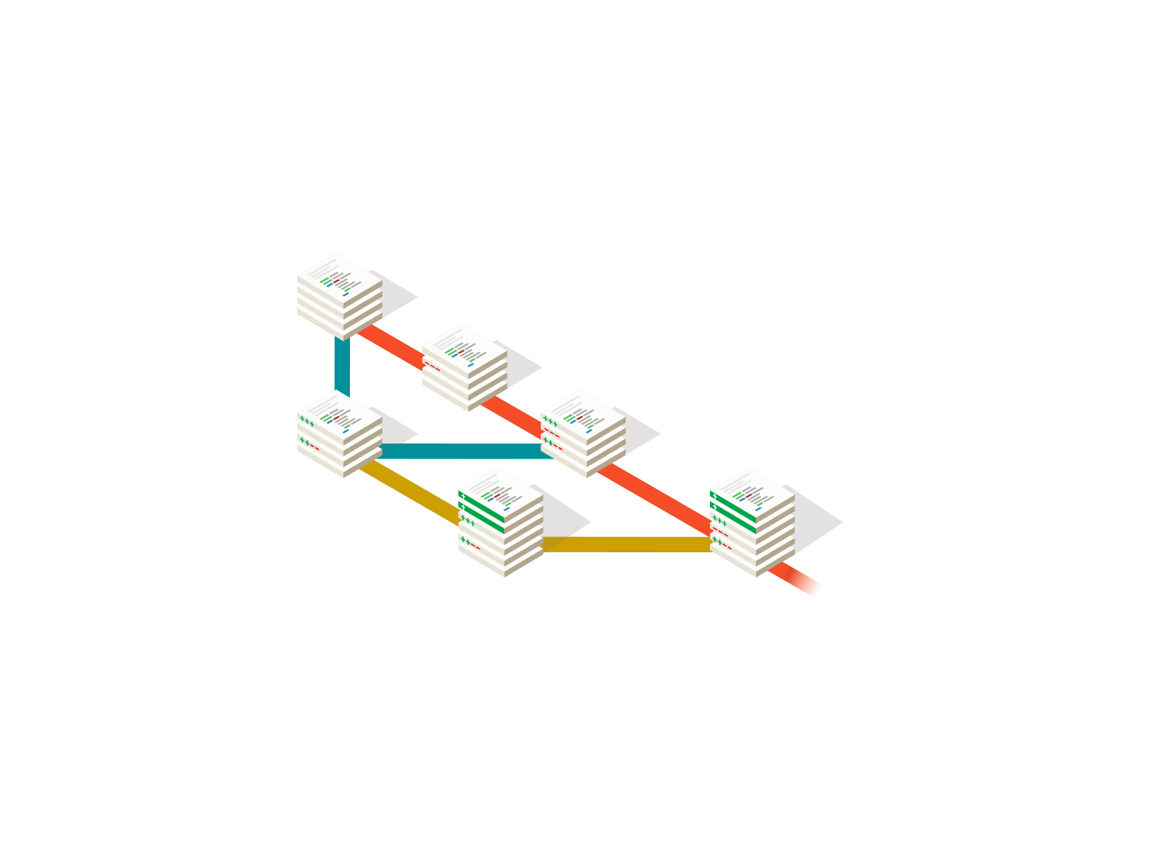
Git
http://git-scm.com/
GitHub
https://github.com/

Slide 7
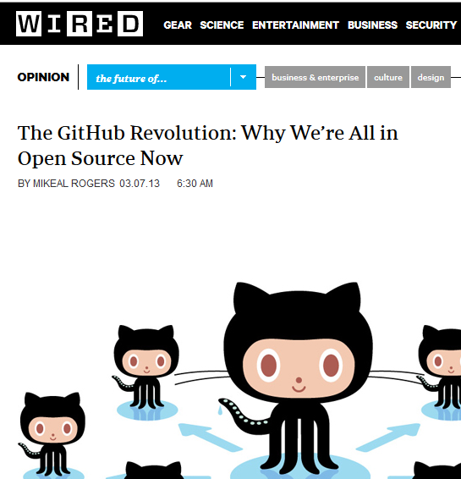
The revolution will not be centralised
http://www.wired.co.uk/news/archive/2013-03/11/github-democracy
Bug tracking a DIY project using GitHub
http://www.wired.com/wiredenterprise/2013/01/this-old-house/
Silicon Valley legal firm have posted set of legal documents for use by digital start-ups
http://www.wired.com/wiredenterprise/2013/03/series-seed/

Slide 8
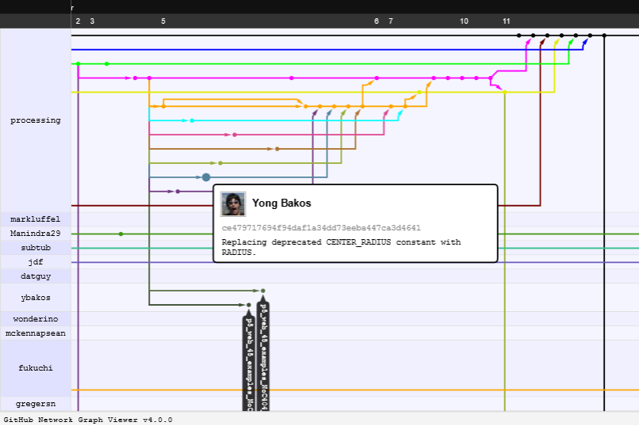
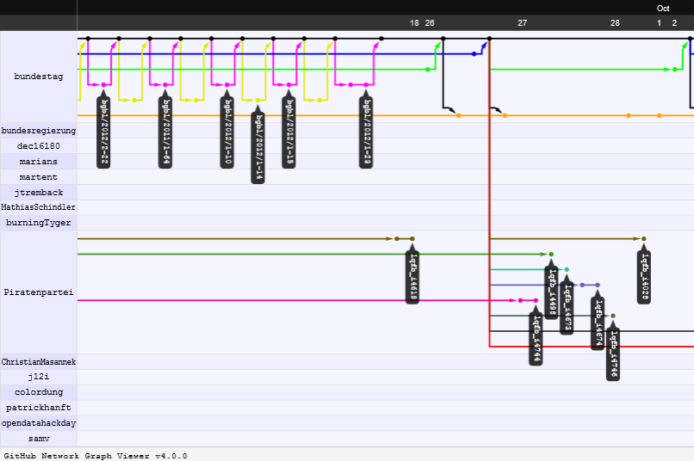
diagrams of GitHub

Slide 9
git commit – collaborative
recording functional changes to the project
git branch – concurrent
decentralizing projects with non-linear development of project strands
git merge – continuous
blending changes from one strand into another

Slide 10


project diagrams
https://github.com/acaudwell/Gource

Slide 11
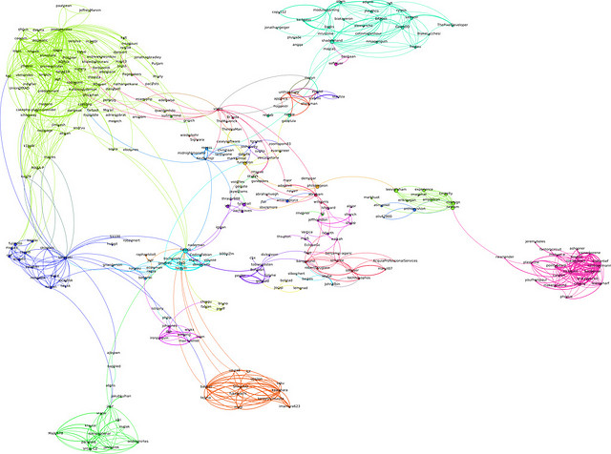
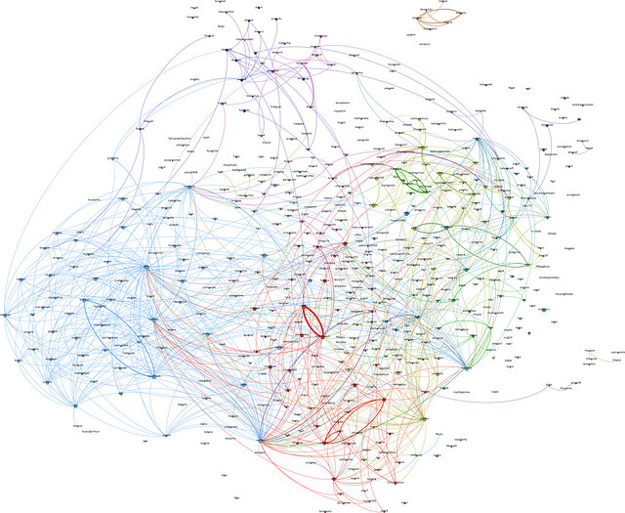
network diagrams
http://lumberjaph.net/graph/2010/03/25/github-explorer.htmlV

Slide 12

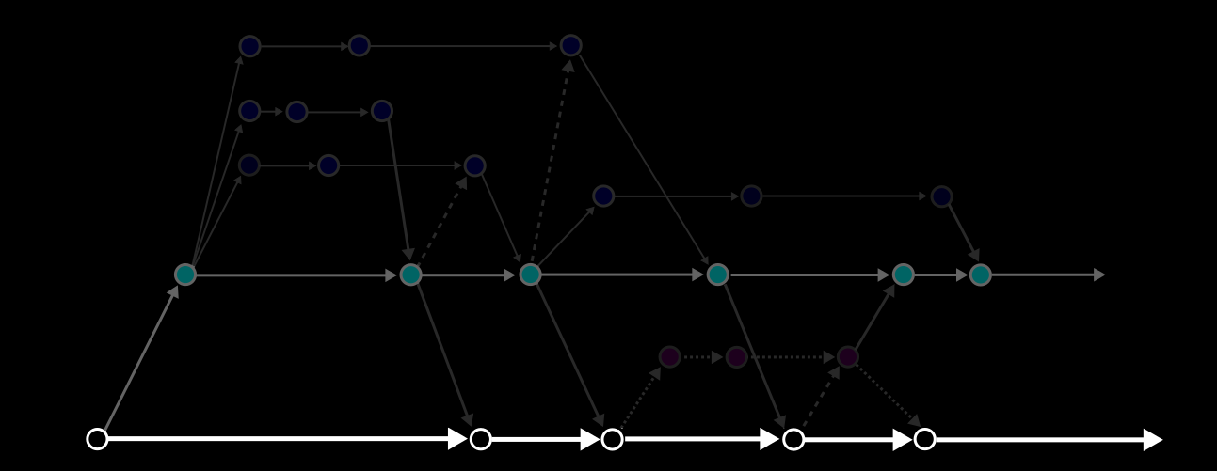
part – component - assembly
collaborate = commit

Slide 13
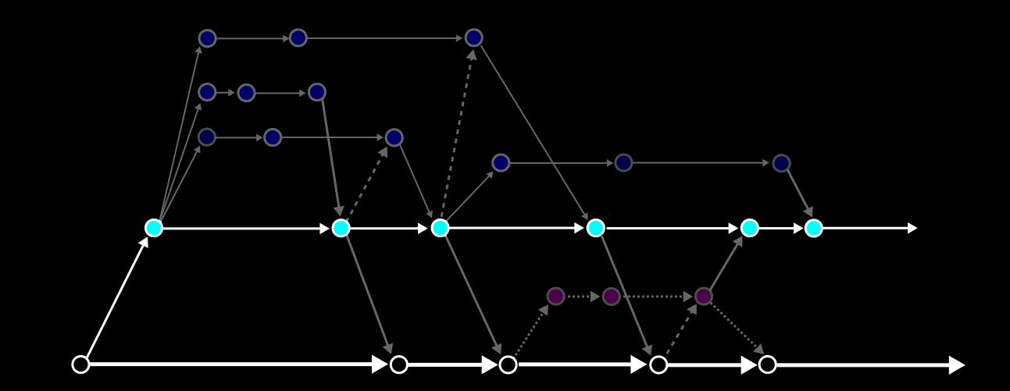
multiple ownership
concurrent = branch

Slide 14
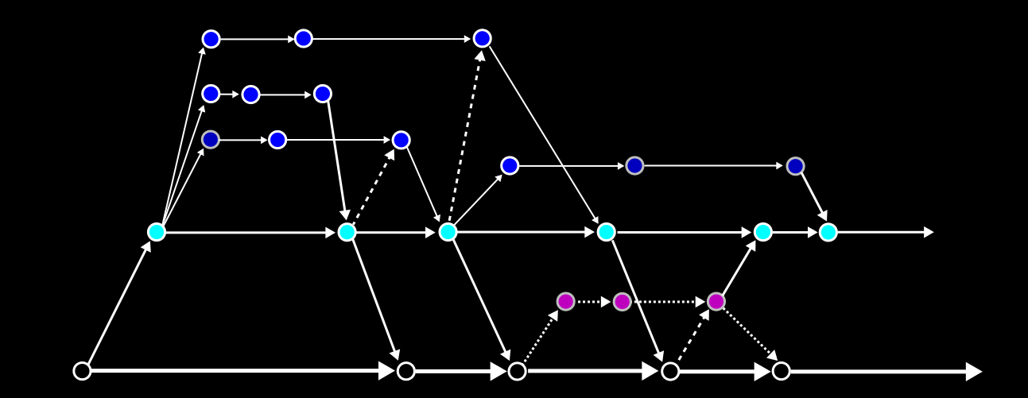
complex authorship
continuous = merge

Slide 15
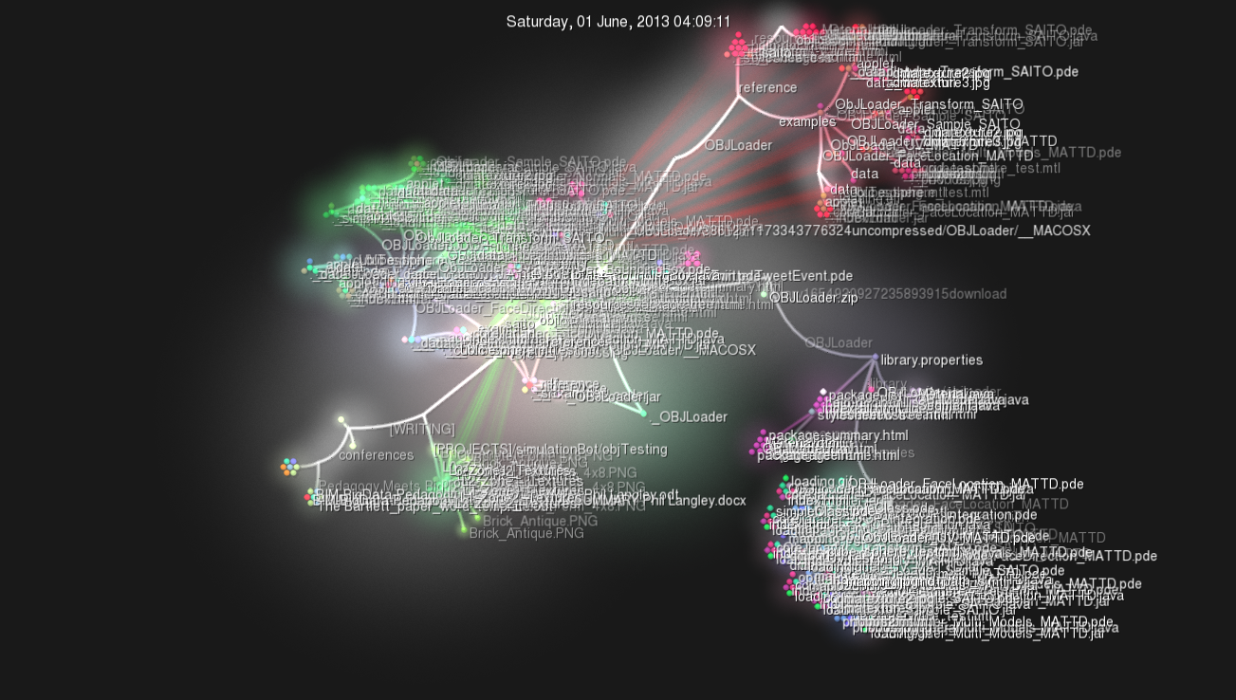
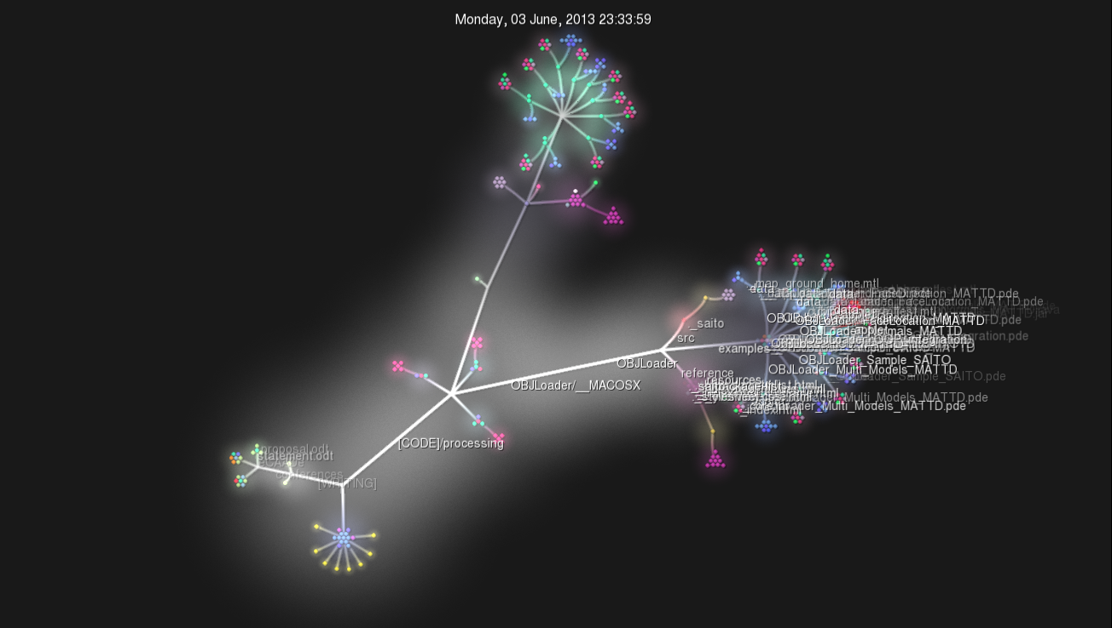
https://github.com/phiLangley/openPHD

Slide 16
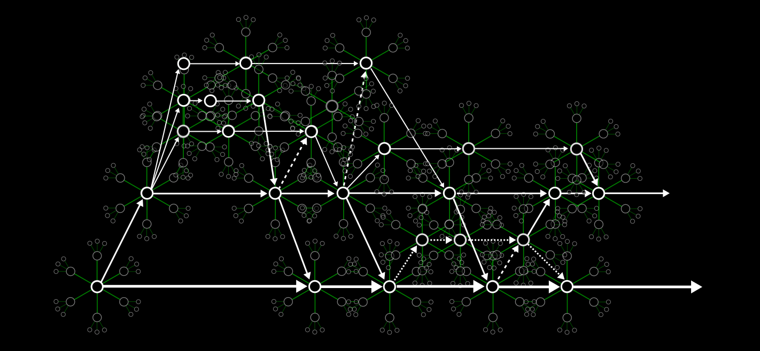
alternative diagrams of BIM

Slide 17
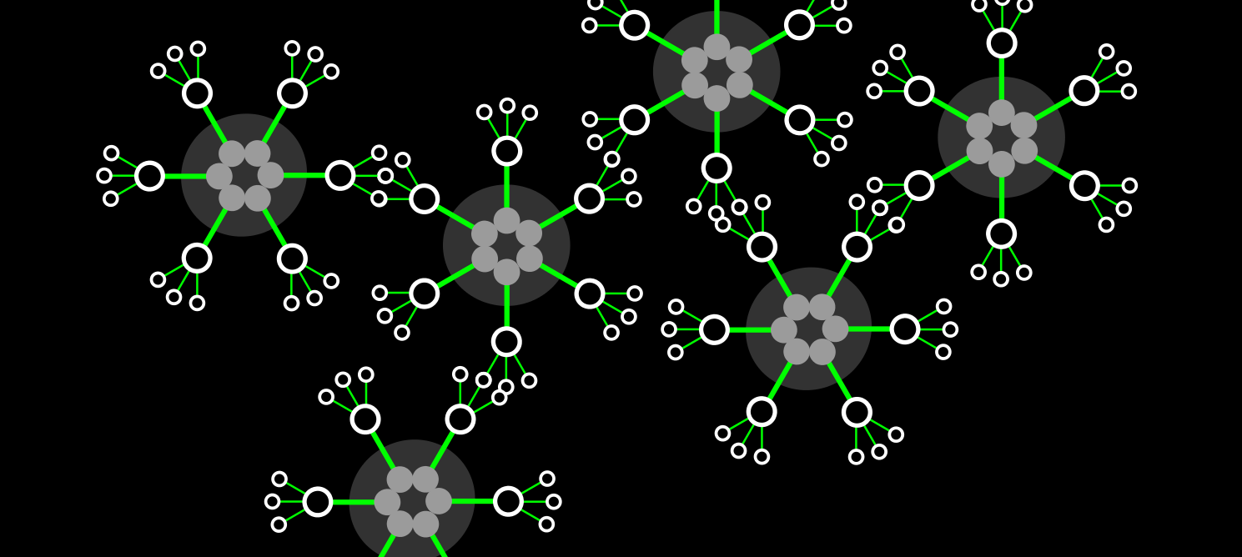
alternative diagrams of BIM

Slide 18
Branch, Merge, Commit – New forms of Open Source for Designing With BIM
Phil Langley
School of Architecture, University of Sheffield
https://github.com/phiLangley
arp12ppl@sheffield.ac.uk

